Slide 1
One-Dimensional Continuous Motion
Dr. Jacob Moore
Associate Professor of Engineering
Penn State Mont Alto

Slide 2
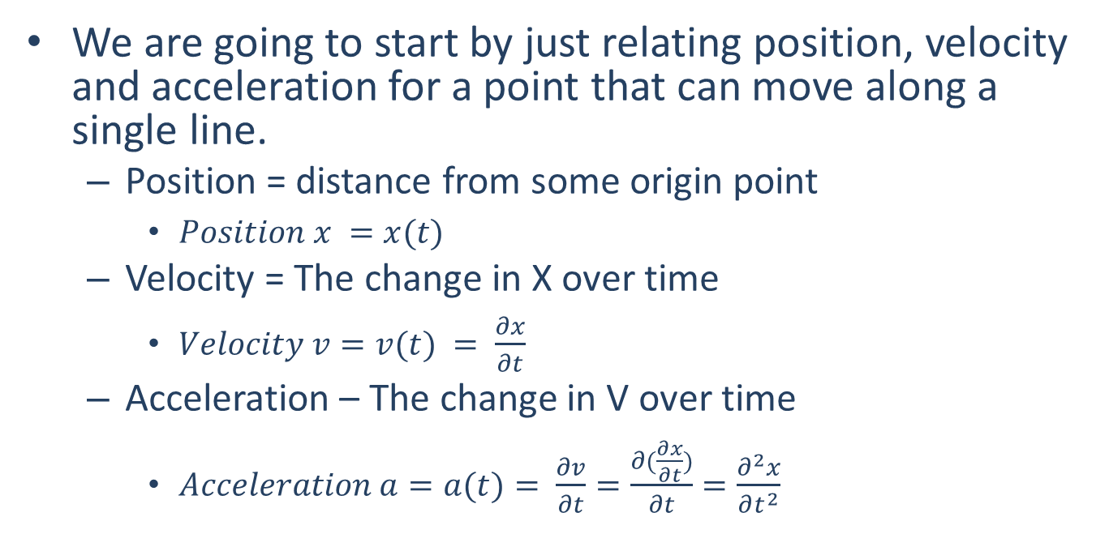
Kinematics
We are going to start by just relating position, velocity and acceleration for a point that can move along a single line.
Position = distance from some origin point
$Position x =x(t)$
Velocity = The change in X over time
$Velocity v=v(t) = \frac{∂x}{∂t}$
Acceleration – The change in V over time
$Acceleration a=a(t)= \frac{∂v}{∂t}=\frac{∂(\frac{∂x}{∂t})}{∂t}=\frac{∂^{2}x}{∂t^{2}}$
p
o
x

Slide 3

Shorthand Symbols
Position : $x(t)$
Velocity : $v\left(t\right)=\frac{dx}{dt}=\dot{x}$(t)
Acceleration : $a(t)=\frac{dv}{dt}=\frac{d^{2}x}{dt^{2}}=\ddot{x}$(t)

Slide 4
Transferring Among Position, Velocity, and Acceleration.
Kinematics problems almost always involve the following process below.
Given that the (position / velocity / acceleration) is described by the function f(t), find it’s (position / velocity / acceleration) over that same time period.
The process of going from one to another is the core of Kinematics.

Slide 5
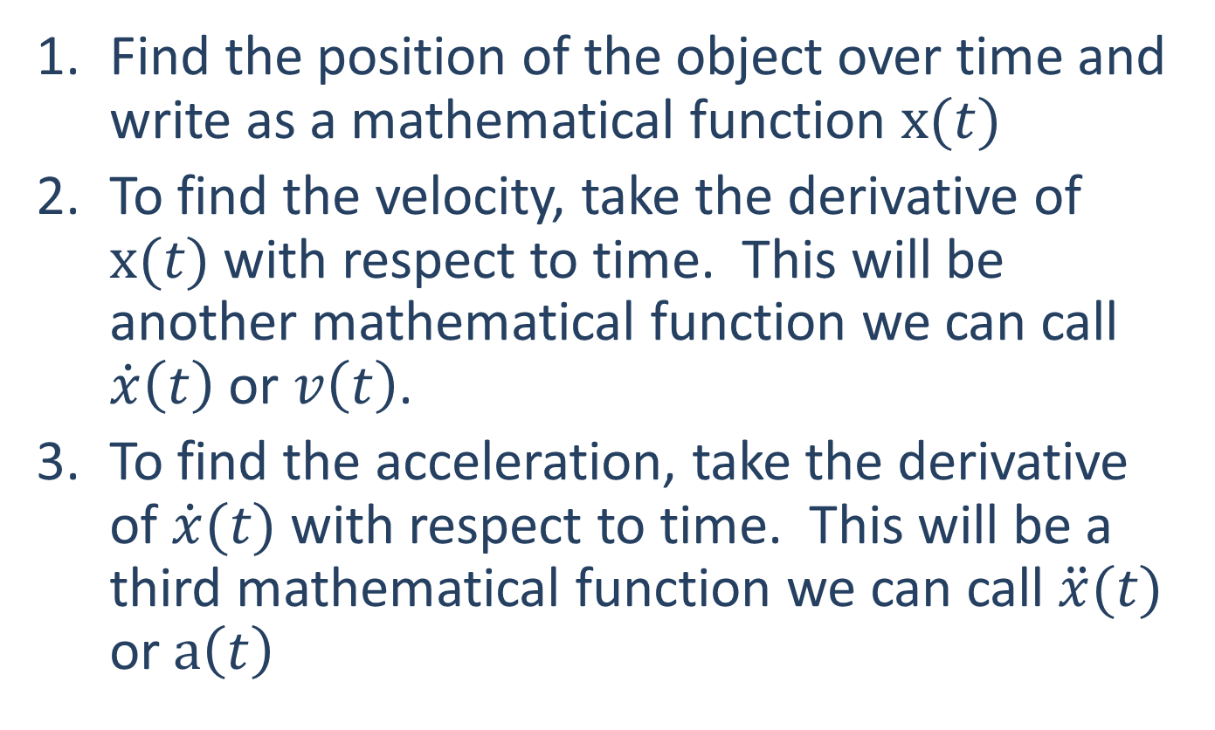
Position → Velocity → Acceleration
Find the position of the object over time and write as a mathematical function $x(t)$
To find the velocity, take the derivative of $x(t)$ with respect to time. This will be another mathematical function we can call $\dot{x}\left(t\right)$ or $v\left(t\right)$.
To find the acceleration, take the derivative of $\dot{x}(t)$ with respect to time. This will be a third mathematical function we can call $\ddot{x}(t)$ or $a\left(t\right)$

Slide 6
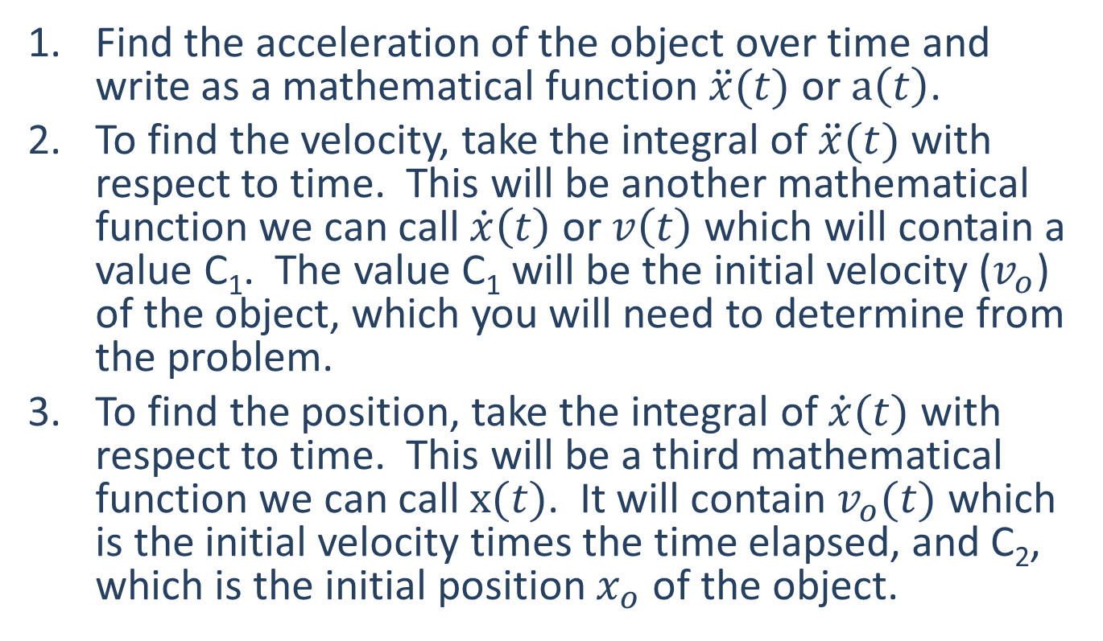
Acceleration → Velocity → Position
Find the acceleration of the object over time and write as a mathematical function $\ddot{x}(t)$ or $a\left(t\right)$.
To find the velocity, take the integral of $\ddot{x}(t)$ with respect to time. This will be another mathematical function we can call $\dot{x}\left(t\right)$ or $v\left(t\right)$which will contain a value C₁. The value C₁ will be the initial velocity ($v_{o}$) of the object, which you will need to determine from the problem.
To find the position, take the integral of $\dot{x}(t)$ with respect to time. This will be a third mathematical function we can call $x(t)$. It will contain $v_{o}(t)$ which is the initial velocity times the time elapsed, and C₂, which is the initial position $x_{o}$ of the object.

Slide 7
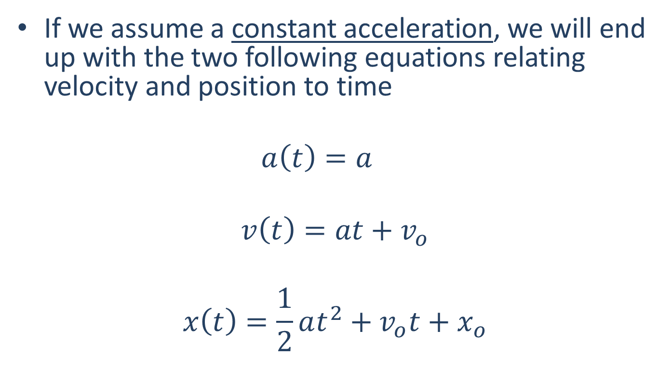
Constant Acceleration Equations
If we assume a constant acceleration, we will end up with the two following equations relating velocity and position to time
$$a\left(t\right)=a$$
$$v\left(t\right)=at+v_{o}$$
$$x\left(t\right)=\frac{1}{2}at^{2}+v_{o}t+x_{o}$$

Slide 8
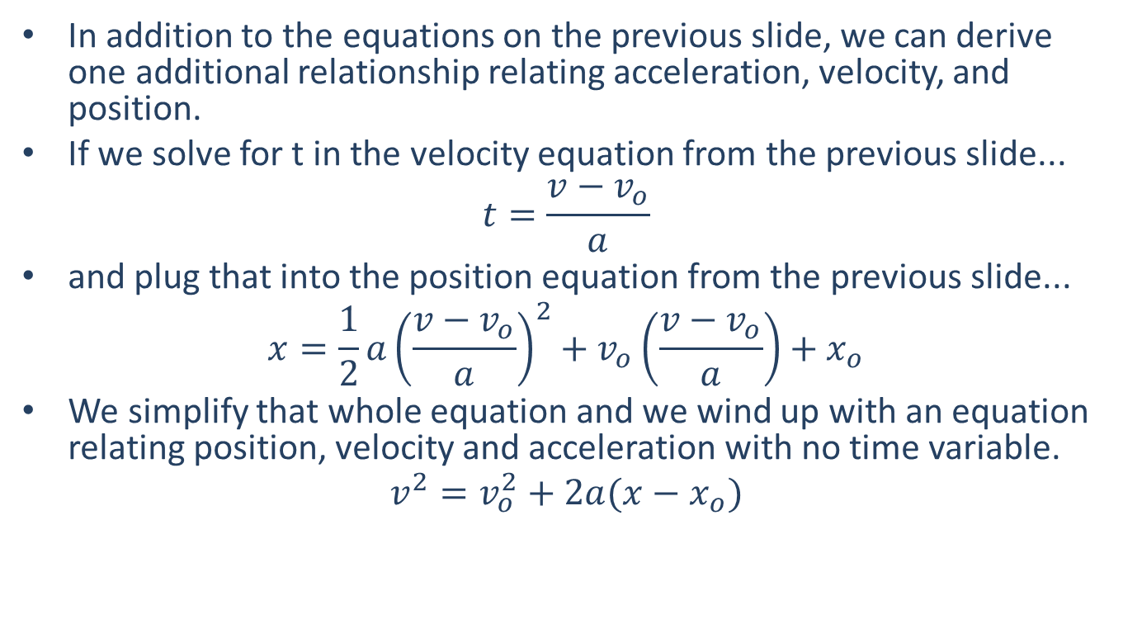
Constant Acceleration Equations
In addition to the equations on the previous slide, we can derive one additional relationship relating acceleration, velocity, and position.
If we solve for t in the velocity equation from the previous slide...
$$t=\frac{v−v_{o}}{a}$$
and plug that into the position equation from the previous slide...
$$x=\frac{1}{2}a{\left(\frac{v−v_{o}}{a}\right)}^{2}+v_{o}\left(\frac{v−v_{o}}{a}\right)+x_{o}$$
We simplify that whole equation and we wind up with an equation relating position, velocity and acceleration with no time variable.
$$v^{2}=v_{o}^{2}+2a(x−x_{o})$$

Slide 9




Non-Continuous Motion
Often a single mathematical function cannot describe the entirety of a problem.
This is called non-continuous motion.
ex: a car accelerates at a constant rate, holds a steady speed for a few seconds, then decelerates at a constant rate.
Ⅰ
Ⅱ
Ⅲ
$$v\left(t\right)$$
$$v\left(t\right)$$
$$v\left(t\right)$$
Velocity
(m/s)
Time
(s)

Slide 10
Non-Continuous Motion
To map out the velocity over time we would need to employ three mathematical expressions.
One for the first few seconds
A second for the next few seconds
A third for the final few seconds
Ⅰ
Ⅱ
Ⅲ
$$v\left(t\right)$$
$$v\left(t\right)$$
$$v\left(t\right)$$
Velocity
(m/s)
Time
(s)

Slide 11
Non-Continuous Motion
Using a graph or data a key points, we can often figure out the equations for each of these three sections.
In addition to the velocity function though, we may also be interested in the acceleration over time or the position over time.
Ⅰ
Ⅱ
Ⅲ
$$v\left(t\right)$$
$$v\left(t\right)$$
$$v\left(t\right)$$
Velocity
(m/s)
Time
(s)

Slide 12
Analyzing Non-Continuous Motion
To analyze non-continuous motion, start by drawing out a graph of position, velocity, or acceleration.
Sometimes this will be given to you, other times you will need deduce what the plot will be from the given information.
Draw everything you know, including the general shapes, equations, and labeling any key points.
Label each section that will require a separate set of equations (I like to use Roman numerals)

Slide 13
Analyzing Non-Continuous Motion
Once we have a graph of one thing (in this case acceleration) we will be taking derivatives or integrals to find the equations for the other plots.
Find the equation for the first section just as you would for a continuous function.
For the second section onward, we will get constants of integration when we integrate that will not necessarily be obvious.

Slide 14
Solving For the Constants of Integration
What helps us solve for the constants of integration is the continuity of the velocity and the position.
We can’t instantly change position or velocity, as that would require infinite acceleration.
If we solve for the velocity or position at the end of one section, it will be the same at the beginning of the next section.
This results also results in velocity graphs that are continuous and position graphs that are continuous without any sudden changes in slope.

Slide 15
Ⅰ
Ⅱ
Ⅲ
Acceleration
(m/s²)
Time
(s)
Velocity
(m/s)
Time
(s)
Position
(m)
Time
(s)

Slide 16
Thanks for Watching
See other engineering mechanics videos and access the full tool at…

Slide 17
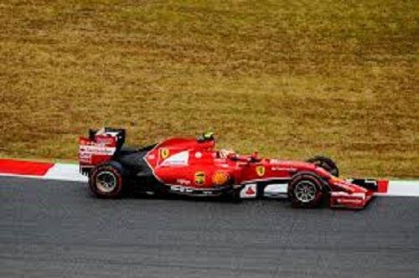
Worked Example
A car accelerates from rest at a rate of 10 m/s² for 10 seconds. The car then immediately begins decelerating at a rate of 4 m/s² for another 25 seconds before coming to a stop. Find the equations for the acceleration, velocity, and position functions over the full 35 second time period and plot these functions.

Slide 18
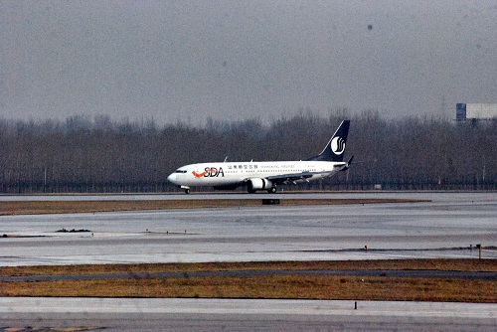
Worked Example
A plane with an initial speed of 95 m/s touches down on a runway. For the first second the plane rolls without decelerating. For the next 5 seconds reverse thrust is applied, decelerating the plane at a rate of 4 m/s². Finally, the brakes are applied with reverse thrust increasing the rate of deceleration to 8 m/s². How long does it take for the plane to come to a complete stop? How far does the plane travel before coming to a complete stop?

Slide 19

Worked Example
A satellite records the velocity function shown below over a sixty second time period. During that same time period determine the acceleration and position functions and draw these functions on a plot.
v(t) = 30t -150
v(t) = 1.5t²
Velocity
(m/s)
Time
(s)
10 s
60 s

